Slide 1

NOIDA INSTITUTE OF ENGINEERING & TECHNOLOGY GREATER NOIDA
MBA Project Management and AMBA0401
Lecture – 1 Project Scheduling and Network Analysis
By
Tarun Maheshwari
Assistant Professor
MBA
NIET, GREATER NOIDA

Slide 2
Index
S No | Content
1 | Name of Subject with code, Course and Subject Teacher
2 | Brief Introduction of Faculty member with Photograph
3 | Evaluation Scheme
4 | Syllabus
5 | Branch wise Application
6 | Course Objective(s)
7 | Course Outcome(s)
8 | Program Outcomes (POs)
9 | COs and POs Mapping
10 | Program Educational Objectives (PEOs)
11 | Result Analysis
12 | End Semester Question paper Templates
13 | Prequisite/Recap

Slide 3
Index
S No | Content
14 | Brief Indtroduction about the Subject with Videos
15 | Unit Content
16 | Unit Objectives
17 | Topic Objectives & Topic Outcome
18 | Lecture related to topic
19 | Daily Quiz
20 | Weekly Assignment
21 | Topic Links
22 | MCQs
23 | Glossary Questions
24 | Old question papers
25 | Expected Questions
26 | Recap of unit

Slide 4
Brief Introduction of the Faculty Member
Faculty Name: Tarun Maheshwari
Designation: ASSISTANT PROFESSOR
Department: PGDM
Email ID: tarun.maheshwari@niet.co.in
Qualification: MBA PG Diploma in Training & Development
Specialization: Finance & Human Resource Management
Teaching Area: Management (Finance & Core subjects)
Total Experience: 11 years

Slide 5
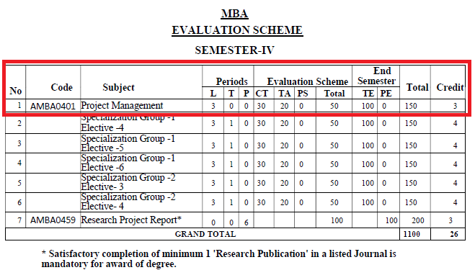
Evaluation Scheme

Slide 6
Syllabus
Course Contents / Syllabus
UNIT-I | Introduction of Project | 06 Hours
Projects – Definition and Objectives – Project Management Vs General Management – Roles and Responsibilities of Project Manager – Selection of Project Manager – Selection of Projects – Understanding Project Life Cycle. Project Team and Scope of Project Management: Characteristics of a Project Team & Project Leader, Project Organization, and Importance of Project Management. Case Studies
UNIT-II | Project Identification & Selection | 08 Hours
Project Identification & Selection: Identification, Generation of ideas, Approaches to Project Screening and Selection, Project Rating Index. Market & Demand Analysis Techniques: Survey & Trend Projection Methods. Project Risk Management: Concepts and Types of Project Risks, Risk Identification, Risks Analysis, Risks Mitigation Strategies. Case Studies
UNIT-III | Budgeting the Project | 08 Hours
Fundamental components of Project Cost, Types of Costs: Direct, Indirect, Recurring, Non-Recurring, Fixed, Variable, Normal, Expedite costs Methods of budgeting – Project cost estimation – Improving cost estimates – Budget uncertainty and risk management – Scheduling the project – Gantt chart – Resource allocation and loading – Social Cost Benefit Analysis (SCBA) of Project: Concept & significance of SCBA, Approaches to SCBA. Case Studies

Slide 7
Syllabus
UNIT-IV | Project Scheduling and Network Analysis | 08 Hours
Steps in Project Scheduling and Network design, Gantt Chart, Work Breakdown Structure (WBS) & Responsibility Assignment Matrix. Project Network Design: Identifying the Nodes and Activities, Activity on Arrow (AoA) and Activities on Node (AoN) methods, Introduction to PERT and CPM, Crashing in Projects. Case Studies
UNIT-V | Monitoring and controlling the project | 6 Hours
Monitoring the project – Control cycle – Project control – Designing the control system – Evaluation of project: Milestone Analysis and Tracking Gantt chart. Earned Value Analysis (EVA): Planned Value (PV), Earned Value (EV), Cost Variance (CV), Schedule Variance (SV), Cost performance Index (CPI), Schedule performance Index (SPI) – Project auditing – Project termination: Types of Terminations, Project Termination Process. Case Studies

Slide 8
Branch Wise Application
Handling projects.
Evaluating & Monitoring Project Process
Taking necessary and corrective action.

Slide 9
Course objective(s)
To empower the students to get insights of basic concepts on project management.
To create awareness on the roles and responsibilities of project manager.
To build the confident among the students to take up any kind of projects.
To sharpen the planning, scheduling and controlling skills of the students with respect to individual projects.
To understand the perspectives in which optimum decisions are to be taken in case of risks with planned activities in project.

Slide 10
Course outcome(s)
CO 1 | Understand the basic concepts and characteristics of Project and Project manager, management | Understanding (K2)
CO 2 | Understand the roles and responsibilities along with tools & techniques used in Project Management | Evaluating (K5)
CO 3 | Develop confident to take up any kind of projects | Evaluating (K5)
CO 4 | Students will understand the scheduling and monitoring process in Project. They will be able to apply PERT and CPM method for project scheduling | Applying (K3)
CO 5 | Students will understand the perspectives in which optimum decisions are to be taken in case of risks with planned activities in project | Creating (K6)

Slide 11
Program outcome (POs)
PO1. Apply knowledge of management theories and practices to solve business problems.
PO2. Foster analytical and critical thinking abilities for data-based decision-making.
PO3. Ability to develop value-based leadership ability.
PO4. Ability to understand, analyze, and communicate global, economic, legal, and ethical aspects of business.
PO5. Ability to lead themselves and others in the achievement of organizational goals, contributing effectively to a team environment.

Slide 12
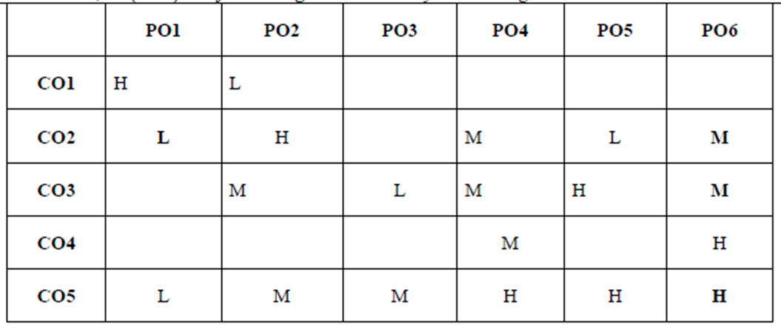
COs and POs Mapping
*1=High, *2=Medium, *3=Low

Slide 13
Program Educational Objectives (PEOs)
PEO 1: Graduates of the management program will have conceptual knowledge, to adapt to the rapidly changing environment, learn new skills and demonstrate application of management principles in a professional work setting.
PEO 2: Graduates will apply appropriate tools for decision making required for solving complex managerial problems in the local or global context.
PEO 3: Graduates of the management program will exhibit integrity, social responsibility, and teamwork.
PEO 4: Graduates will exhibit ethics, communication skills, leadership qualities and entrepreneurial mindset using creativity and innovation.

Slide 14
Result Analysis

Slide 15
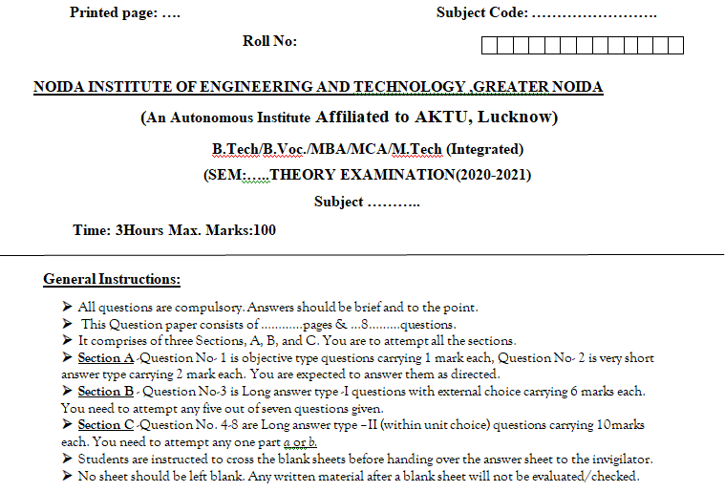
End Semester Question paper Templates

Slide 16
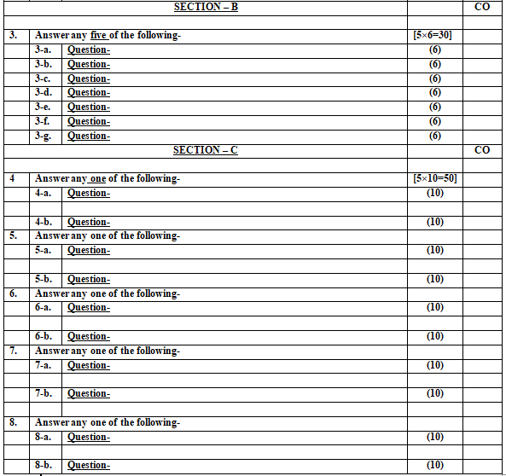
End Semester Question paper Templates

Slide 17
Prerequisite /Recap
Prerequisites for this session are:
General understanding of project management.
Moderate analytical skills.
Recap:
Project techniques.

Slide 18
Brief Introduction about the Subject with Videos
Project management is the discipline of initiating, planning, executing, controlling, and closing the work of a team to achieve specific goals and meet specific success criteria.
It involves the application of knowledge, skills, tools, and techniques to project activities to meet project requirements.
Effective project management ensures that projects are completed within scope, on time, and within budget, while delivering the desired outcomes.
https://www.youtube.com/watch?v=EyPFi0YO32M
https://www.youtube.com/watch?v=BOU1YP5NZVA

Slide 19
Unit Content
Unit-4:
Steps in Project Scheduling and Network design
Gantt Chart, Work Breakdown Structure (WBS) & Responsibility Assignment Matrix.
Project Network Design: Identifying the Nodes and Activities, Activity on Arrow (AoA) and Activities on Node (AoN) methods, Introduction to PERT and CPM, Crashing in Projects.

Slide 20
Unit objective
Objectives of this unit are:
To make the students learn about scheduling the project.
To make to students understand and apply various project scheduling and network analysis techniques.

Slide 21
Topic Objectives & Topic Outcome
s. no. | topic | outcome
1 | Project Scheduling and Network Analysis | CO3
2 | Project Scheduling and Network design | CO3

Slide 22
Project scheduling
Project scheduling is a mechanism to communicate what tasks need to get done and which organizational resources will be allocated to complete those tasks in what timeframe.
A project schedule is a document collecting all the work needed to deliver the project on time.

Slide 23
Project Planning vs Project Scheduling
Project Planning primarily involves selecting the appropriate policies, methodologies, and procedures required to deliver the project on time.
Project Scheduling, on the other hand, converts the plans, scope, and cost into an operational timeline.

Slide 24
Steps in Project Scheduling
Step 1: Plan Schedule Management
Step 2: Define Activities
Step 3: Sequence Activities
Step 4: Estimate Activity Resources
Step 5: Estimate Activity Durations
Step 6: Develop Schedule

Slide 25
Step 1: Plan Schedule Management
Plan Schedule Management is the process of establishing the policies, procedures, and documentation for planning, developing, managing, executing, and controlling the project schedule.
The key benefit of this process is that it provides guidance and direction on how the project schedule will be managed throughout the project.

Slide 26
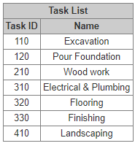
Step 2: Define Activities

Slide 27
Step 3: Sequence Activities
Sequence Activities is the process of identifying and documenting relationships among the project activities.
The key benefit of this process is that it defines the logical sequence of work to obtain the greatest efficiency given all project constraints.

Slide 28
Task Dependencies (Four Types)
Finish to Start (FS): This is the most common dependency. When tasks A and B have an “FS relationship,” task B cannot start until task A finishes.
Finish to Finish (FF): When tasks A and B have an FF relationship, task B cannot finish until task A finishes.
Start to Start (SS): When tasks A and B have an SS relationship, task B cannot start until task A starts.
Start to Finish (SF): When tasks A and B have an SF relationship, task B cannot finish until task A starts.

Slide 29
Leads & Lags
Lead- The amount of time whereby a successor activity can be advanced concerning a predecessor activity.
For example, if tasks A and B have an FS relationship with a lead of 5 days, task B cannot start until 5 days after task A has finished.
Lag: The amount of time whereby a successor activity will be delayed concerning a predecessor activity.
For example, if tasks A and B have an FS relationship with a lag of 5 days, task B cannot start until 5 days before task A has finished.

Slide 30
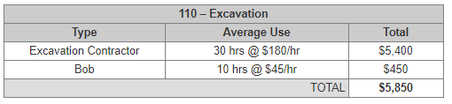
Step 4: Estimate Activity Resources

Slide 31
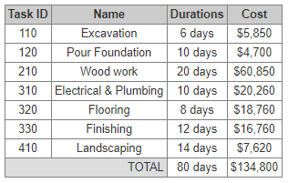
Step 5: Estimate Activity Durations

Slide 32
Methods of Estimation
1. Analogous Estimating: In this method, you consult the actual data from a previous or related project. Even if it has some differences from the current project, you can analyze those differences and apply a correction factor.
2. Parametric Estimating: In this method, you break down the project into its fundamental units that have well-known and understood unit rates.
For example, the square footage of a house.

Slide 33
Methods of Estimation contd…
Three Point Estimating: When you have no real good data to go from, you can estimate the highest possible number (optimistic), and the lowest (pessimistic) as well as the most likely. Then you can use a triangular distribution (average them), or use a beta distribution.
Normal Distribution: Estimate = (Optimistic + Most Likely + Pessimistic) / 3
Beta Distribution: Estimate = (Optimistic + 4 x Most Likely + Pessimistic) / 6

Slide 34
Step 6: Develop a Schedule
Developing a Schedule is the process of analyzing activity sequences, durations, resource requirements, and schedule constraints to create the project schedule model.
The key benefit of this process is that by entering scheduled activities, durations, resources, resource availabilities, and logical relationships into the scheduling tool, it generates a schedule model with planned dates for completing project activities.

Slide 35
Gantt Chart
Henry Gantt, American Engineer, 1917
Gantt charts are used to show calendar time task assignments in days, weeks, or months. The tool uses graphic representations to show the start, elapsed, and completion times of each task within a project.
Gantt charts are ideal for tracking progress. These charts serve as a valuable budgeting tool and can show funds allocated versus funds spent

Slide 36
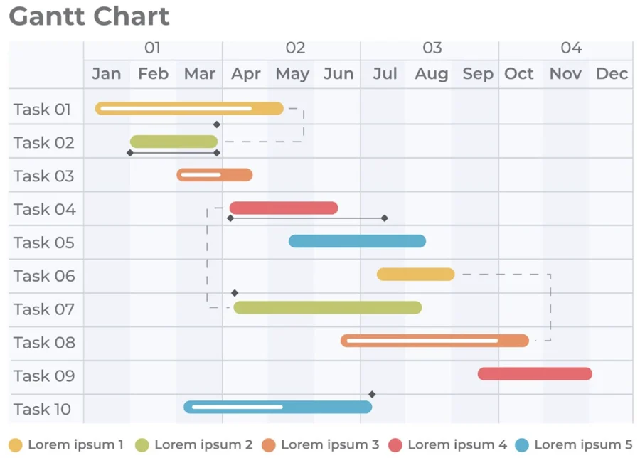
Gantt Chart

Slide 37
Benefits of using a Gantt chart
Enables better project control by promoting clearer communication.
Becomes a tool for negotiations.
Shows the actual progress against the planned schedule.
Can report results at appropriate levels.
Allows comparison of multiple projects to determine risk or resource allocation.
Rewards the project manager with more visibility and control over the project.

Slide 38
Topic objective and topic outcome
s.no. | topic | CO
1 | To understand and apply the WBS in planning and managing the projects. | CO2

Slide 39
Work Breakdown Structure
WBS produces a detailed list of tasks to be performed for a project, helping to deliver a better costing, scheduling and resource planning for a project.
Purpose of WBS is to help plan effectively for a project by breaking key tasks & activities down into more manageable & smaller units of works.

Slide 40
Benefits of using Work Breakdown Structure
To allocate & delegate responsibility to help accomplish different tasks or activities.
Sequencing & scheduling the time of different events to improve the effectiveness of how time is allocated.
Improves resource planning & efficiency of how resources are consumed.
Used as a basis for financial exception reporting

Slide 41
Responsibility Assignment Matrix (RAM)
A Responsibility Assignment Matrix (RAM) describes the participation of various organizations, people, and roles in completing tasks or deliverables for a project.
It’s used by the Program Manager (PM) to clarify roles and responsibilities in cross-functional teams, projects, and processes.
A Request for Proposal (RFP) might request a RAM from a contractor.

Slide 42
RACI
Responsible: Those who do the work to achieve the task. There is typically one role with a participation type of Responsible, although others can be delegated to assist in the work required.
Accountable: The one ultimately accountable for the correct and thorough completion of the deliverable or task, and the one to whom Responsible is accountable. In other words, an Accountable must sign off (Approve) on work that Responsible provides. There must be only one Accountable specified for each task or deliverable

Slide 43
RACI
Consulted: Those whose opinions are sought; and with whom there is two-way communication.
Informed: Those who are kept up-to-date on progress, often only on completion of the task or deliverable; and with whom there is just one-way communication.

Slide 44
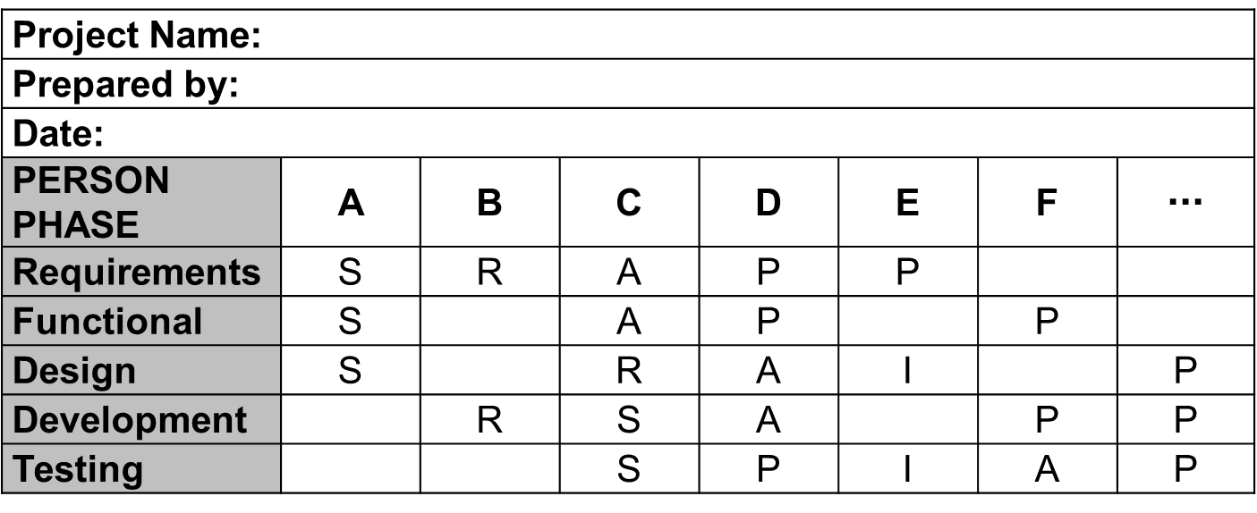
Responsibility Assignment Matrix (RAM)
P= Participant
A= Accountable
R = Review Required
I = Input Required
S = Sign-off Required

Slide 45
Topic objective and topic outcome
s.no. | topic | CO
1 | To identify the nodes and activities in a project. | CO4

Slide 46
Identifying Nodes & Activities
In an activity-on-arrow network, activities are represented by a line between two circles.
The first circle represents the start of the activity and is known as the start event (sometimes called the i-node).
The second circle represents the finish of the activity and is known as the finish event (sometimes called the j-node).

Slide 47
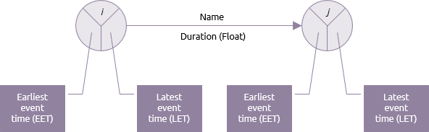
Identifying Nodes & Activities

Slide 48
Activity on Arrow (AOA)
In AoA diagrams, showing the finish-to-start relationships is a limited affair. What this means is that the arrow represents the period from the event at the start of the arrow to the event at the end.
Activities that are represented as arrows have to be added to illustrate some of the more complicated relationships and dependencies that are present between the activities.

Slide 49
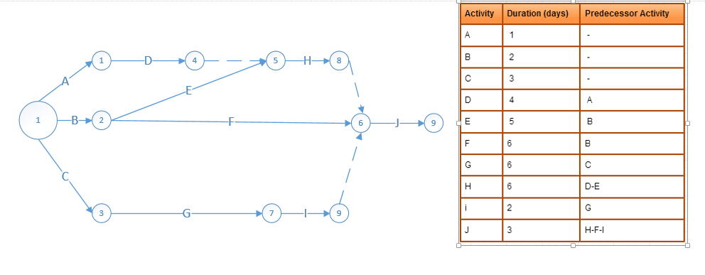
Activity on Arrow (AOA)

Slide 50
Activity on Node (AON)
In AoN diagrams, the activity is placed on the node. The interconnection arrows would illustrate the dependencies that are there between the activities.
They’re more flexible and are capable of illustrating the main relationship types. Since the activity is on a node, the data usually can be placed on the activity. Click on the AoN template below to start editing it.

Slide 51
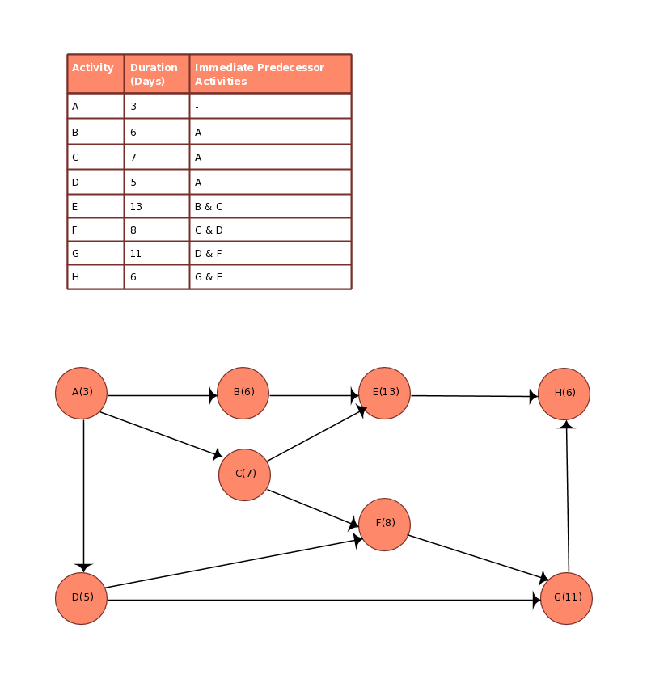
Activity on Node (AON)

Slide 52
Topic objective and topic outcome
s.no. | topic | CO
1 | To understand and apply PERT & CPM in managing projects | CO4

Slide 53
Program Evaluation Review Technique (PERT)
PERT is a planning and control tool used for defining and controlling the tasks necessary to complete a project.
PERT charts and Critical Path Method (CPM) charts are often used interchangeably; the only difference is how task times are computed.

Slide 54
Program Evaluation Review Technique (PERT)
A graphic representation called a "Project Network" or "CPM Diagram" is used to portray graphically the interrelationships of the elements of a project and to show the order in which the activities must be performed.

Slide 55
Steps in PERT planning
1.Identify the specific activities and milestones.
The activities are the tasks of the project. The milestones are the events that mark the beginning and the end of one or more activities.
2. Determine the proper sequence of activities.
This step may be combined with above step since the activity sequence is evident for some tasks.

Slide 56
Steps in PERT planning
3. Construct a network diagram.
Using the activity sequence information, a network diagram can be drawn showing the sequence of the successive and parallel activities.
4. Estimate the time required for each activity.
Weeks are a commonly used unit of time for activity completion, but any consistent unit of time can be used.

Slide 57
Steps in PERT planning
For each activity, the model usually includes three-time estimates:
1 . Optimistic time: The shortest time in which the activity can be completed.
2. Most likely time: The completion time has the highest probability.
3. Pessimistic time: The longest time that an activity may take.
Expected Time = (Optimistic + 4 x Most Likely + Pessimistic) / 6

Slide 58
Steps in PERT planning
5. Determine the critical path.
The critical path is determined by adding the times for the activities in each sequence and determining the longest path in the project.
If the critical path is not immediately obvious, it may be helpful to determine the following four times for each activity:
ES - Earliest Start time
EF - Earliest Finish time
LS - Latest Start time
LF - Latest Finish time

Slide 59
Steps in PERT planning
6. Update the PERT chart as the project progresses.
As the project unfolds, the estimated times can be replaced with actual times.

Slide 60
Benefits Of PERT
Improved planning and scheduling of activities.
Improved forecasting of resource requirements.
Identification of repetitive planning patterns which can be followed in other projects, thus simplifying the planning process.
Ability to see and thus reschedule activities to reflect interproject dependencies and resource limitations following know priority rules.

Slide 61
Critical Path Method (CPM)
Critical path is the sequential activities from start to the end of a project. Although many projects have only one critical path, some projects may have more than one critical paths depending on the flow logic used in the project.

Slide 62
Steps in CPM
Step 1: Activity specification
You can use the Work Breakdown Structure (WBS) to identify the activities involved in the project. This is the main input for the critical path method.
In activity specification, only the higher-level activities are selected for critical path method.
When detailed activities are used, the critical path method may become too complex to manage and maintain.

Slide 63
Steps in CPM
Step 2: Activity sequence establishment
In this step, the correct activity sequence is established. For that, you need to ask three questions for each task of your list.
Which tasks should take place before this task happens.
Which tasks should be completed at the same time as this task.
Which tasks should happen immediately after this task.

Slide 64
Steps in CPM
Step 3: Network diagram
Once the activity sequence is correctly identified, the network diagram can be drawn.
Although the early diagrams were drawn on paper, there are several computer software, such as Primavera, for this purpose nowadays.

Slide 65
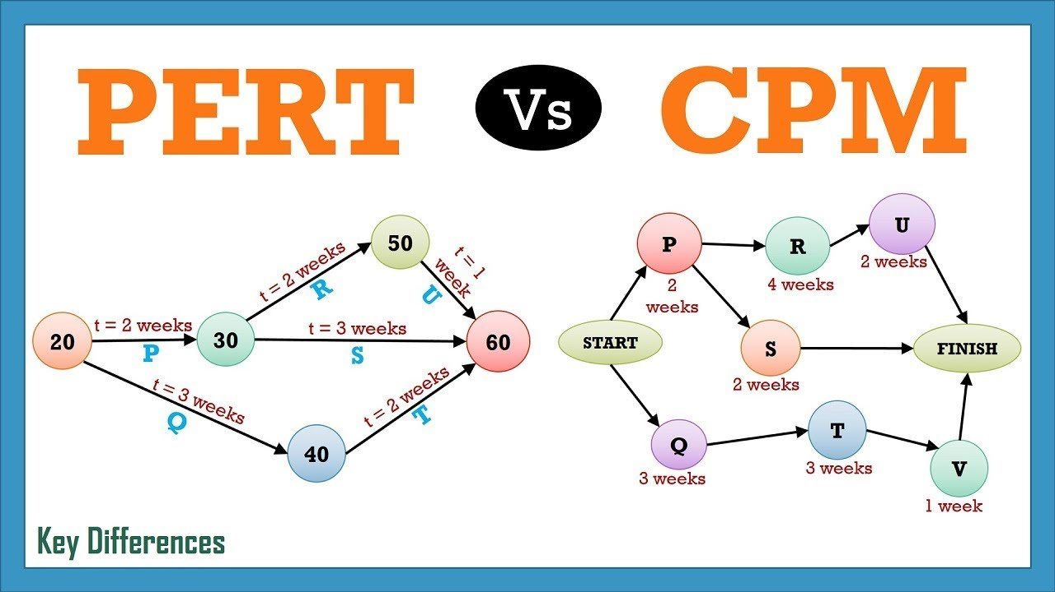
PERT vs CPM

Slide 66
Topic objective and topic outcome
s.no. | topic | CO
1 | To learn how and when to crash the projects. | CO3

Slide 67
Crashing in Project
Crashing is a schedule compression technique used to reduce or shorten the project schedule. Methods are:
Adding additional resources to the critical path tasks This option has various constraints such as the securing of the budget to add the resources and the availability of the resources.
Reduce the project requirements or scope This can be done only if the sponsor and major stakeholders agree to reduce the scope

Slide 68
Situations when to crash a project
The project is delayed
Avoiding a delay in an upcoming phase
Project team will be moved to another project
Availability of free resources
Resources for training
There are time bonuses

Slide 69
Steps in Project Crashing
Step 1: Analyze the critical path.
Step 2: Identify all tasks that can be shortened with additional resources.
Step3: Calculate for each task: trade-off, gain, time reduction
Step 4: Choose the least costly approach.
Step 5: Provide a crashing budget and updated baseline to the sponsor.

Slide 70
Case Study

Slide 71
Daily quiz
Q1. Discuss the fixed cost.
Q2. Describe the variable cost.
Q3. Explain the normal and expedite cost.
Q4. Explain the top down budgeting.
Q5. Discuss the bottom of budgeting.

Slide 72
Daily quiz
Q6. Following primarily involves selecting the appropriate policies, methodologies, and procedures required to deliver the project on time.
Project Planning
Project Scheduling
Project termination
None of the above
Q7. The following process converts the plans, scope, and cost into an operational timeline.
Project Planning
Project Scheduling
Project termination
None of the above

Slide 73
Daily quiz
In task dependencies, FS stands for.
First sight
Finish to start
Final to start
None of the above
In task dependencies, FF stands for.
First Finish
Finish to Finish
Final to Final
None of the above

Slide 74
Weekly assignment
Q1. Discus the steps in project scheduling and network design.
Q2. Discuss the Activity on Arrow (AoA) and Activity on Node (AoN)
Q3. Describe the Work Breakdown Structure (WBS)
Q4. Explain the PERT and CPM techniques of network design and analysis.

Slide 75
Topic links
https://www.youtube.com/watch?v=SkQzQCAWf8M
https://www.youtube.com/watch?v=Rq19ga0U_jQ
https://www.youtube.com/watch?v=jh-3c6WBhBE
https://www.youtube.com/watch?v=Wc-n6dr9vrk

Slide 76
MCQs
Q1. In task dependencies, SS stands for.
Start sight
Start to Sight
Start to start
None of the above
Q2. In task dependencies, SF stands for.
Start to Final
Start to First
Start to Finish
None of the above

Slide 77
MCQs
Q3. The amount of time whereby a successor activity can be advanced with respect to a predecessor activity.
Lead
Lag
Leaf
None of the above
Q4. The amount of time whereby a successor activity will be delayed with respect to a predecessor activity.
Lead
Lag
Leaf
None of the above

Slide 78
MCQs
Q5. Normal Distribution is calculated as.
Estimate = (Optimistic + Most Likely + Pessimistic) / 3
Estimate = (Optimistic + Most Likely + Pessimistic) / 2
Estimate = (Optimistic + Most Likely + Pessimistic) / 4
None of the above
Q6. Beta Distribution is calculated as.
Estimate = (Optimistic + 4 x Most Likely + Pessimistic) / 6
Estimate = (Optimistic + 4 x Most Likely + Pessimistic) / 4
Estimate = (Optimistic + 4 x Most Likely + Pessimistic) / 8
None of the above

Slide 79
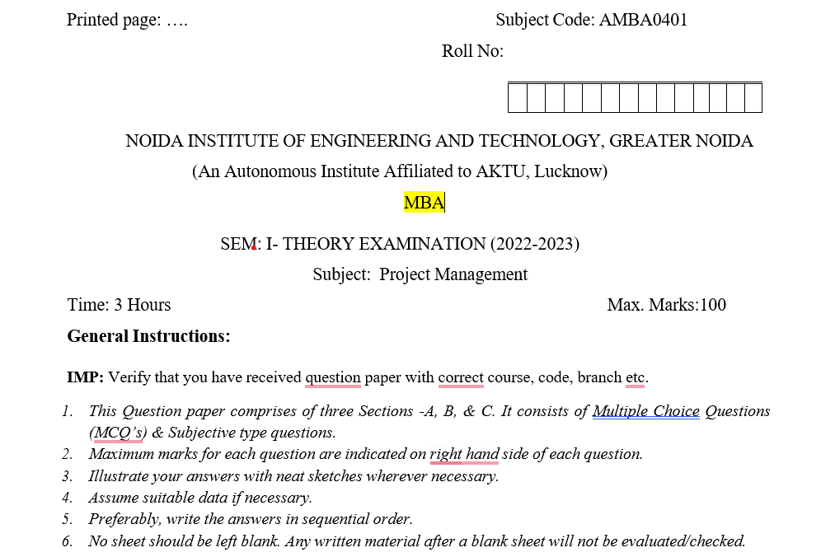
Old question paper

Slide 80
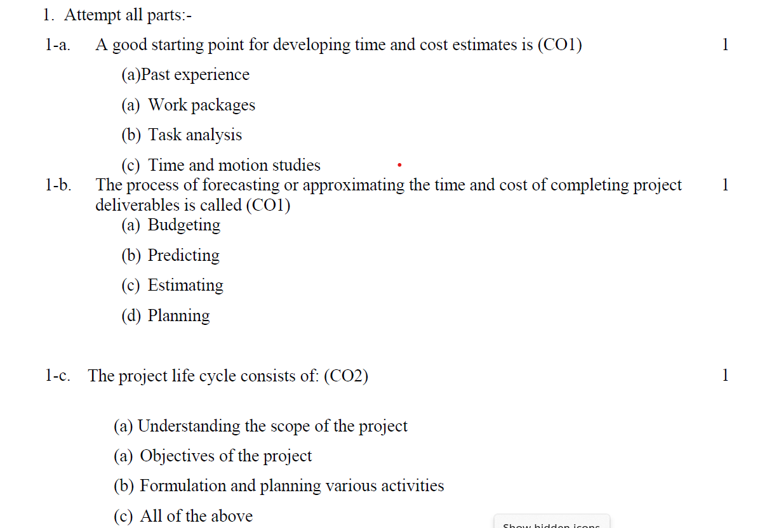
Old question paper

Slide 81
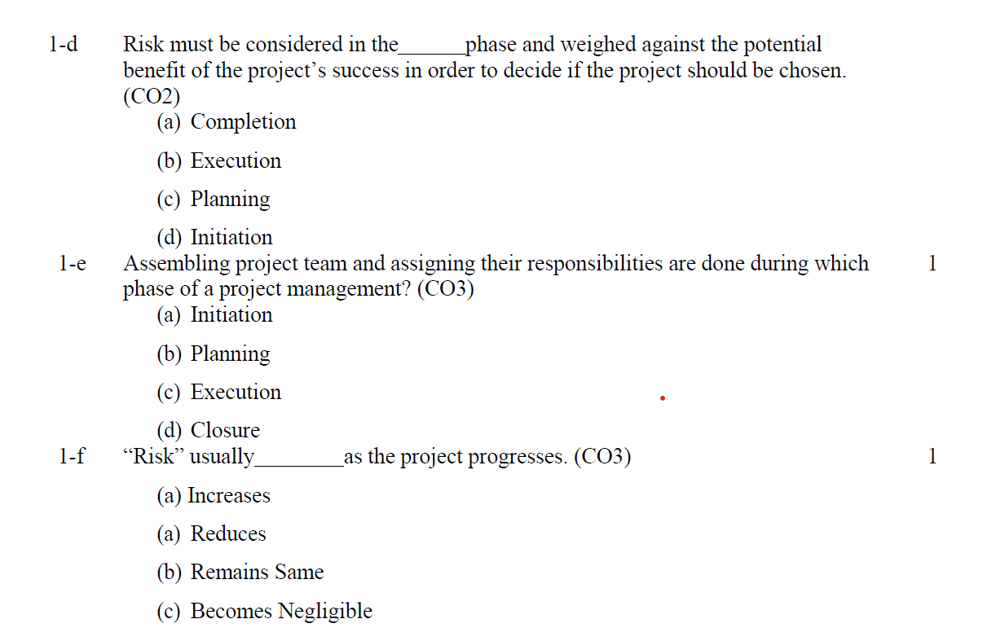
Old question paper

Slide 82
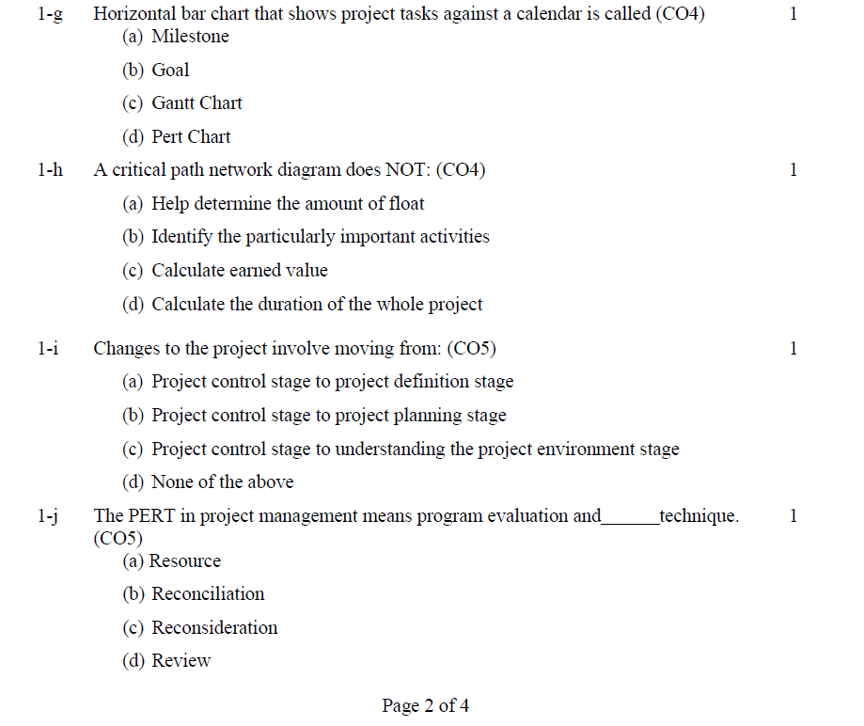
Old question paper

Slide 83
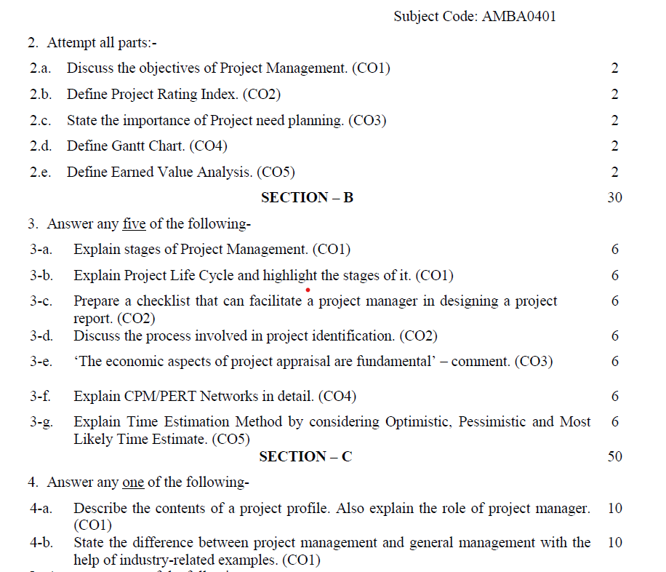
Old question paper

Slide 84
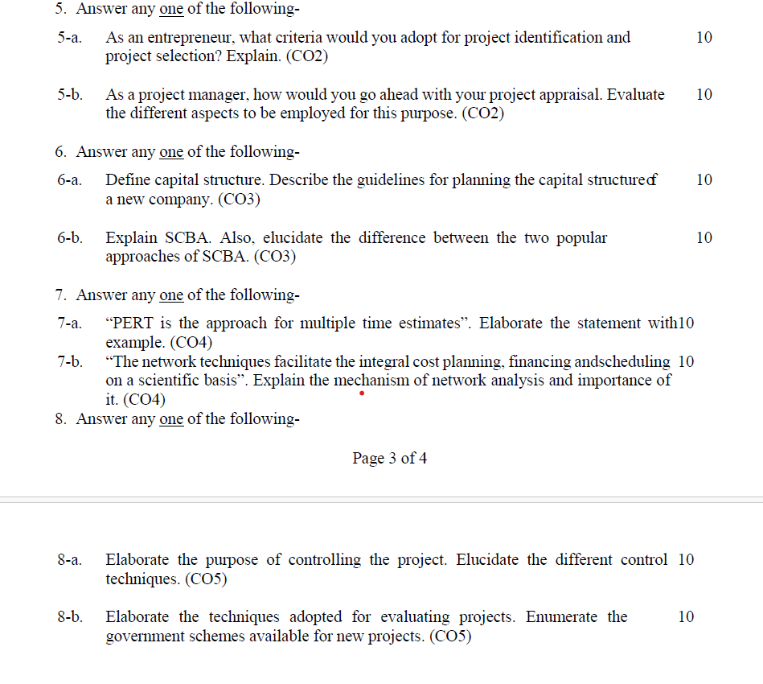
Old question paper

Slide 85
Expected Questions
Q1. Discuss the project scheduling.
Q2. Explain the term network analysis in project management.
Q3. What are the various steps in project scheduling process.
Q4. Discuss the process of identifying nodes and activities in a project network design.

Slide 86
Recap of unit
Project scheduling is a mechanism to communicate what tasks need to get done and which organizational resources will be allocated to complete those tasks in what timeframe.
Gantt charts are used to show calendar time task assignments in days, weeks or months.
Crashing is a schedule compression technique used to reduce or shorten the project schedule.

